Slide 1
CSE 12 – Basic Data Structures and Object-Oriented Design Lecture 4
Greg Miranda & Paul Cao, Winter 2021
This lecture is being recorded

Slide 2
Announcements
Quiz 4 due Wednesday @ 8am
PA1 due Wednesday @ 11:59pm

Slide 3
Topics
Lecture 4 Exercises
Implement/Test insert and remove methods for ArrayLists

Slide 4
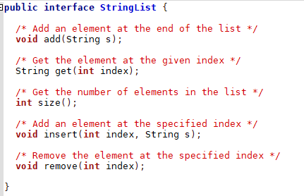

During the pre-lecture recording, we commented out insert and remove method. Why?
We didn’t plan to implement them at that time and commenting out them will make our code cleaner
We didn’t plan to implement them and commenting them out will avoid a compiler error
We were overloading those two methods
None of the above

Slide 5
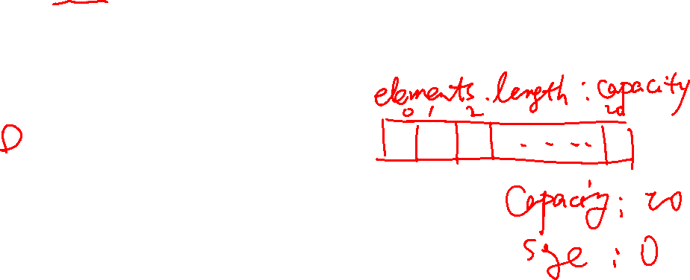
In the ArrayStringList class, we have the following fields
String[] elements;
int size;
What’s the point of having size as instance variable as the array elements already has size?
It is duplicate information for ease of use
It avoid calling element.length to save time
size indicates how full the array is
More than one of the above is correct

Slide 6
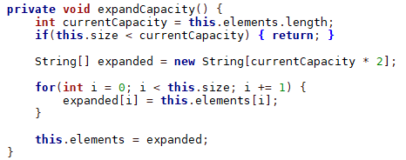
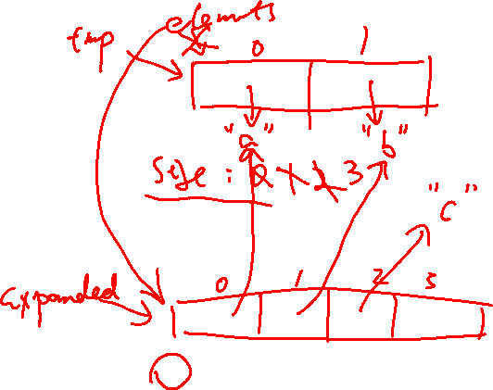
In the ArrayStringList class, we have a private helper method expandCapcity
If I have a foo function inside the ArrayStringList class and have the following code
what will be printed out? Assume that the array starts empty and has a capacity of 2.
public void foo(){
String[] tmp = elements;
add(“a”); add(“b”); add(“c”);
expandCapacity();
System.out.println(tmp == elements);
}
true
false
there will be a compiler error
there will be a runtime error

Slide 7

In the ArrayStringList class, we have a private helper method expandCapcity
When do I need to call this expandCapacity function?
Inside the constructors
Inside the insert method
Inside the remove method
Inside the get method
Inside the add method

Slide 8
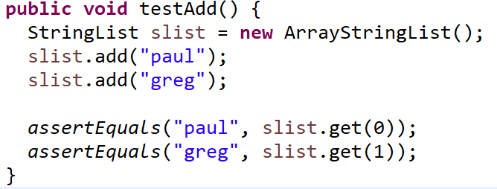

In our tester for add, we wrote the code for inserting two elements and test if we added properly. Can I write my tester as
assertEquals(slist.get(0), “paul”);
assertEquals(slist.get(1), “greg”);
Yes they are basically the same as what we wrote in pre-lecture video
No you can’t switch the order as it will generate the wrong test result
No you can’t switch the order as it makes the interpretation of the test result inaccurate

Slide 9
ArrayList Insert
/* Add an element at the specified index */
void insert(int index, String s);
Write a test case for the ArrayList insert method
Implement the ArrayList insert method

Slide 10
ArrayList Remove
/* Remove the element at the specified index */
void remove(int index);
Write a test case for the ArrayList remove method
Implement the ArrayList remove method

